Slide 1
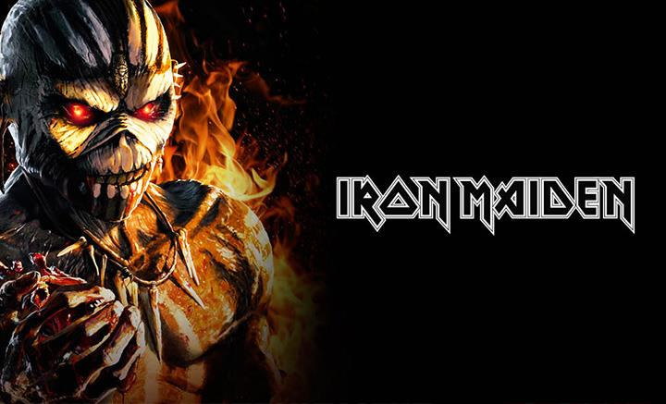
By : Eneko and Mattin

Slide 2
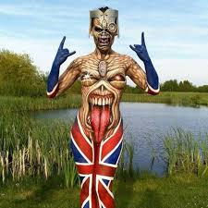
CHRONOLOGY
The Beatles: 1960 Queen: 1970
Iron Miden: 1975
Cold Play 1996 The cure: 1976
Oasis 1991
Pink Floyd, 1964 Sex pistols: 1975
The Rolling Stones 1962
The Who: 1962 Radiohead 1985
Deep purple: 1968 Arctic Monkeys, 2002
Led Zeppelin: 1968

Slide 3
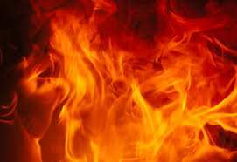
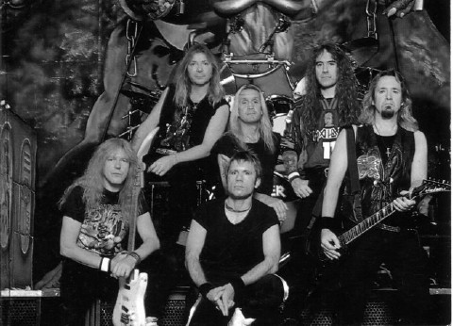

Slide 4
Iron Maiden is an English heavy metal band formed in Leyton, East London, in 1975 by bassist and primary songwriter Steve Harris. The band's discography has grown to thirty-eight albums, including sixteen studio albums, eleven live albums, four EPs, and seven compilations.Pioneers of the new wave of British heavy metal, Iron Maiden achieved initial success during the early 1980s. After several line-up changes, the band went on to release a series of UK and US platinum and gold albums.

Slide 5
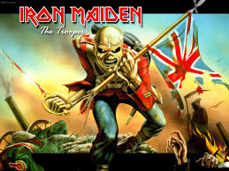
TRADUCTION
You'll take my life but I'll take yours too
You'll fire your musket but I'll run you through
So when you're waiting for the
next attack
You'd better stand there's no turning
back…..
Bizitza kenduko diate bina nik ere beraiei kenduko diet.
Tirokatu egingo naute bain nik aurre egingo diet tiroei.
Hurrengo erasoa itxoiten ari direnean.
Hobe dute irautea, atze buelta ez dago eta.
Zaldia izerditan dago, galopatzen hasten gara.
Arma Errusiarren soinu poderetsua.
Gizakiek egindako hesiaren aurka gindoazela.
Minduen garrasiak, nire kamaradak erortzen idren bitartean
Lurrean dauden gorputz hilak sahiestuz
Eta Errusiarrek beste deskarga bat egiten dute.
...The horse he sweats with fear we
break to run
The mighty roar of the Russian guns
And as we race towards the
human wall
The screams of pain as my comrades
fall.
We hurdle bodies that lay on the ground
And the Russians fire another round

Slide 6
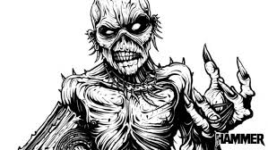
https://en.wikipedia.org/wiki/Iron_Maiden
http://www.theaquarian.com/2016/03/30/the-beast-is-back-an-interview-with-iron-maiden/

